Slide 1
Unit Testing in Angular
COURSE OVERVIEW

Slide 4
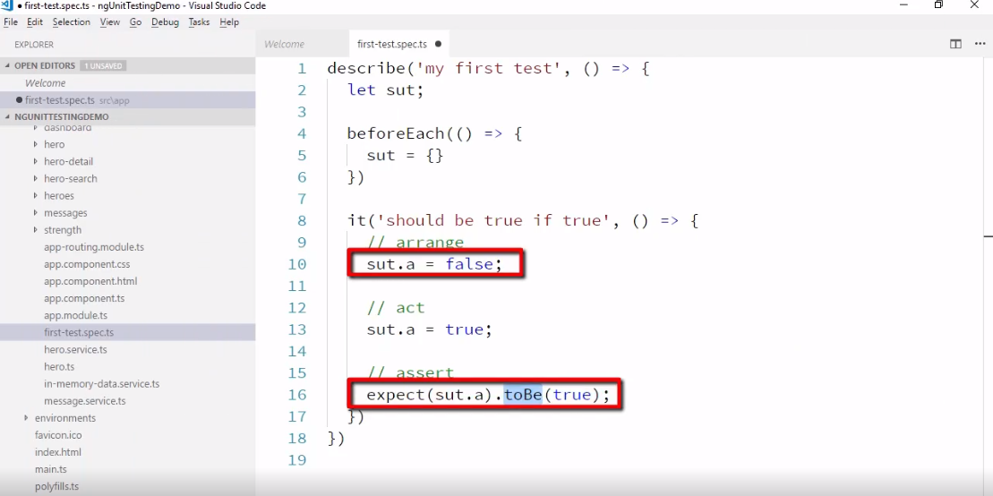

Slide 5
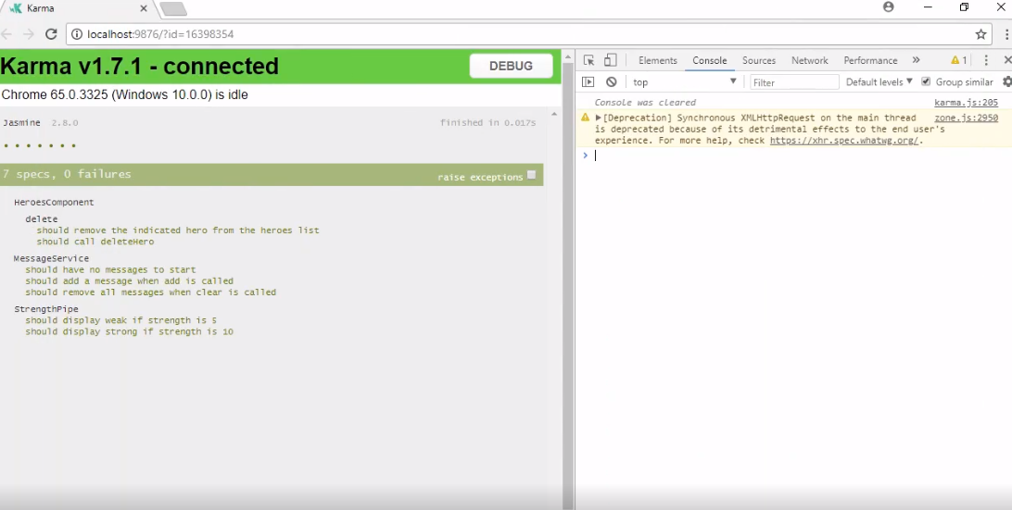

Slide 7
